Slide 1
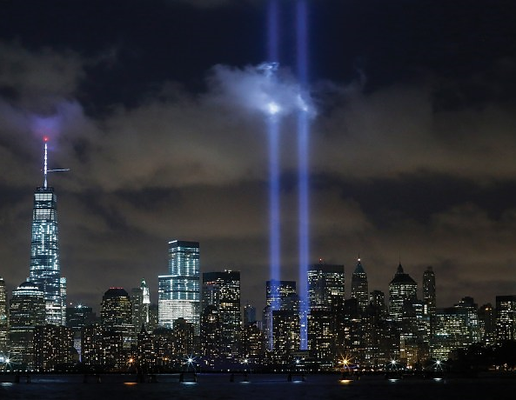
Patriot Day
Sunday, September 11, 2022
(to be shared with students Friday, September 9, 2022)
Six months after the Twin Towers fell in New York City in 2001, they returned in the form of two blue beams of light illuminating the Manhattan skyline. Since then, they have lit the sky annually as a September 11th commemoration known as Tribute in Light. The blue beams illuminate the New York City sky just south of the Memorial site.

Slide 2
.
September 11, 2001 is the tragic day that forever changed the lives of all Americans.
On September 11, 2001, 19 terrorists associated with the terrorist group al-Qaeda hijacked four jet airliners and carried out suicide attacks against the United States in New York City, Washington, D.C., and Pennsylvania.

Slide 3
The September 11, 2001 terrorist attacks caused tremendous death and destruction. Two planes were flown into the Twin Towers in New York City. A third plane hit the Pentagon just outside of Washington, D.C. A fourth plane crashed in a farm field near Shanksville, Pennsylvania.

Slide 4
Nearly 3,000 innocent people were killed during the attacks on September 11, 2001, including more than 400 police officers and firefighters. The attacks triggered major U.S. efforts to fight terrorism world-wide that continue today.

Slide 5
In memory of those who died during the terrorist attacks, each September 11th is remembered as Patriot Day.
This year marks the 21st anniversary of the tragic events which changed the lives of all Americans.

Slide 6
The National September 11 Memorial Museum in New York City is the principal memorial and museum commemorating the September 11 attacks of 2001, which killed nearly 3,000 people, and the World Trade Center bombing of 1993, which killed six people.
The National September 11 Memorial Museum in New York City is the principal memorial and museum commemorating the September 11 attacks of 2001, which killed nearly 3,000 people, and the World Trade Center bombing of 1993, which killed six people.

Slide 7
The Pentagon Memorial, located just southwest of The Pentagon in Virginia, is a permanent outdoor memorial to the 184 men and women who died as victims in the building and on American Airlines Flight 77 during the attacks on September 11, 20The Pentagon Memorial, located just southwest of The Pentagon in Virginia, is a permanent outdoor memorial to the 184 men and women who died as victims in the building and on American Airlines Flight 77 during the attacks on September 11, 2001. 01.
The Pentagon Memorial, located just southwest of The Pentagon in Virginia, is a permanent outdoor memorial to the 184 men and women who died as victims in the building and on American Airlines Flight 77 during the attacks on September 11, 2001.

Slide 8
The Flight 93 Memorial in Shanksville, Pennsylvania is located near the crash site of Flight 93, which was hijacked during the terrorist attacks on September 11, 2001. The memorial honors the passengers and crew of Flight 93 who stopped the terrorists from reaching their target, possibly in Washington, D.C.

