Slide 1
Communication Evaluation
SS.7.C.2.11 Analyze media and political communications (bias, symbolism, propaganda).
Media and Political Communication

Slide 2
Have you ever seen a political ad?
What do you remember about the ad?
Was it about the candidate or the candidate’s opponent?
Would you say it was a positive ad or a negative ad?
Notes:
Discuss examples provided by the students. Have students recall any details about the ad and what it told you about the candidate.

Slide 3
What do you want to know?
When watching an ad for a political candidate, what kind of information should be included?
Work in a small group to come up with a list.
Notes:
Lesson 2.9 asked students to evaluate candidates for political office. Review with students some of the criteria they looked at (age, character, education, experience, martial status, personality, physical health, political party, religion, etc).
Follow up questions:
What are some important things you would want to know about candidates before you vote?
When ads are focused on a candidates’ opponent, what do you think of that candidate?

Slide 4
Communication Evaluation
On your handout, read the definitions and put them in your own words.
Do not fill in the third column with examples – that will come later!

Slide 5
Bias
Display of favor for or against someone or something; often seen as prejudicial.
How would you define it?

Slide 6
Symbolism
The use of symbols to represent ideas.
How would you define it?

Slide 7
Propaganda
Communication aimed at influencing public attitudes or opinions toward some cause or position. Propaganda is often used to manipulate human emotions by displaying facts selectively.
How would you define it?
Notes:
http://www.peta.org/blog/peta-uk-child-abuse-ad-makes-bbcs-top-10-controversial/

Slide 8
Which is it?
The following slides will have examples of bias, symbolism, and propaganda – can you identify which is which?

Slide 9
Symbolism
The use of symbols to represent ideas.

Slide 10
Bias
Display of favor of or against one thing, person, or group compared with another.

Slide 11
Propaganda
Ideas or statements that are often false or exaggerated and that are spread in order to help a cause, a political leader, and/or a government.
Notes:
http://www.peta.org/blog/peta-uk-child-abuse-ad-makes-bbcs-top-10-controversial/

Slide 12
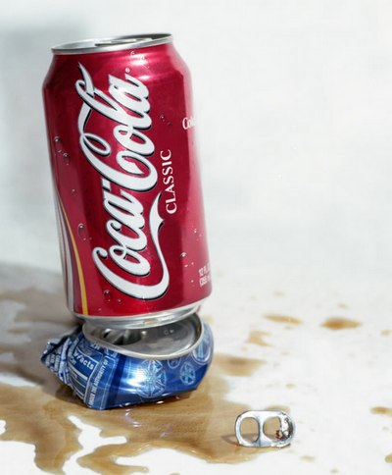
Bias
Display of favor of or against one thing, person, or group compared with another.

Slide 13
Propaganda
Ideas or statements that are often false or exaggerated and that are spread in order to help a cause, a political leader, and/or a government.

Slide 14
Symbolism
The use of symbols to represent ideas.

Slide 15
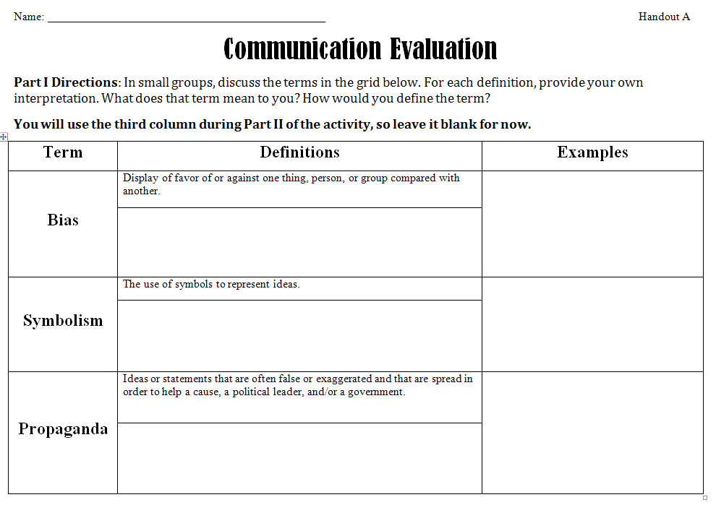
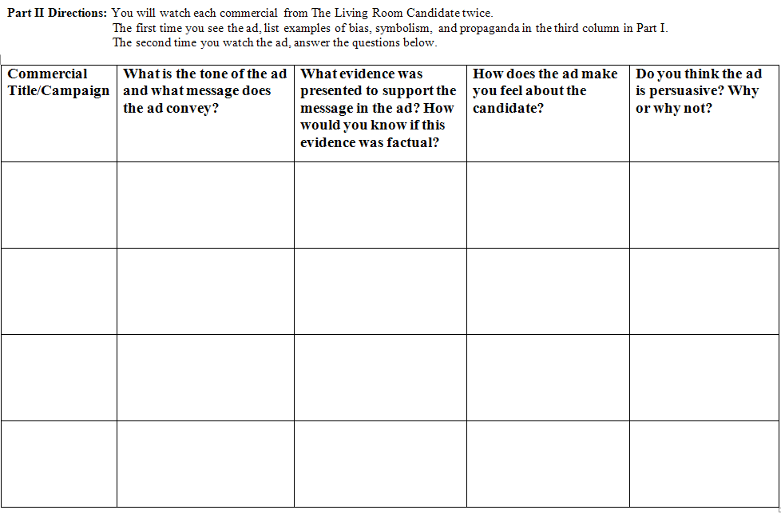
Bias, symbolism, and propaganda in Political Ads http://www.livingroomcandidate.org/
You will be viewing 4 political ads.
List examples of bias, symbolism, and propaganda from the ads in column 3 on Part I of your handout
Complete Part II of your handout after the second viewing of the ad.

Slide 16
Answer the question below:

