Slide 1
Sorting Out the Courts
SS.7.C.3.11: Diagram the levels, functions, and powers of the courts at the state and federal levels.

Slide 2
PUZZLED!
Using the clues on the pieces, assemble the puzzles!
You should have two triangles when you are finished.

Slide 3
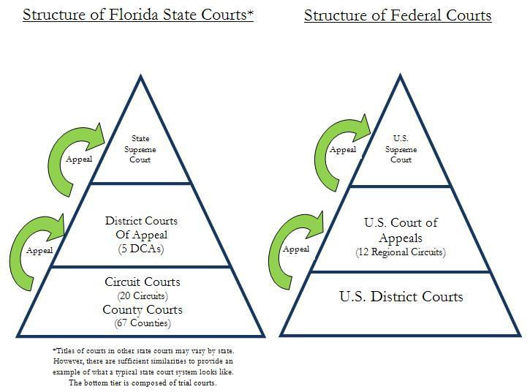
Puzzled

Slide 4
The Role of the Judicial Branch

Slide 5
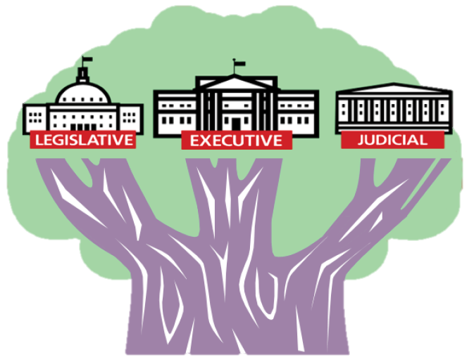
Three Branches of Government
Legislative Branch – Makes the law
Executive Branch – Enforces the law
Judicial Branch – Interprets and applies the law

Slide 6
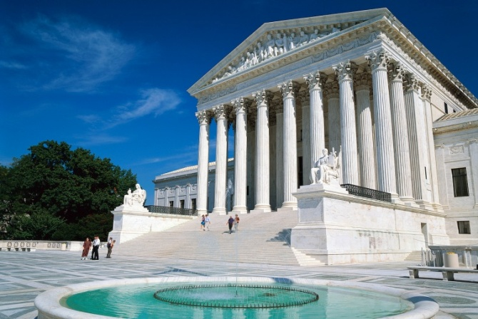
The Role of the Judicial Branch (courts)
The Constitution outlines our rights…
…and the courts protect our rights.
The courts also:
Review laws
Explain laws
Resolve disputes
Decide if a law goes against the Constitution

Slide 7
The Role of Judges and Justices
Judges and Justices interpret and apply the law
Decisions have to be based on facts & law.
  Constitution
  Statutes
  Legal reasoning
  Precedent: prior cases
  Higher court decisions
  And more
Notes:
Judges are found in trial courts and in the lower appellate courts. Justices are found in the Florida Supreme Court and U.S. Supreme Court.

Slide 8
Two Court Systems
State and Federal Courts

Slide 9


Two Court Systems: Federal and State
The judicial branch is divided into two parallel court systems:
federal courts
and state courts.

Slide 10

Where do courts get their power and jurisdiction*?
The Constitution of the State of Florida
What does “jurisdiction” mean?
Legal authority a court has to hear a case.
United States
Constitution
Federal courts deal with issues granted to them by the U.S. Constitution and federal law.
State courts deal with issues granted to them by their constitutions and state statutes. They also handle legal issues not granted to the federal courts or denied to the states.
Notes:
Definition from http://www.law.cornell.edu/wex/jurisdiction

Slide 11
Trial and Appellate Courts
What is the difference?

Slide 12
Trial and Appellate
In addition to being divided into federal and state courts…
…courts are then broken down into trial and appellate courts.
Trial | Appellate
Trial | Appellate

Slide 13
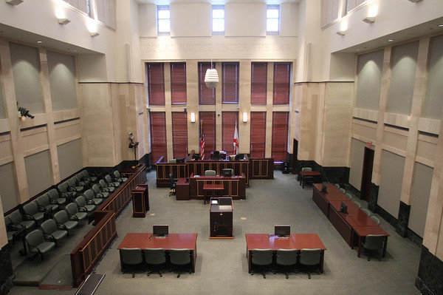
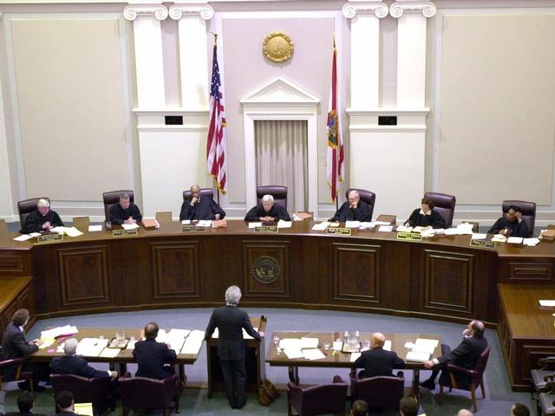
2 Courtrooms, Big Differences
Trial Courtroom
Appellate Courtroom
Courtroom A
Courtroom B
On your Sorting the Courts Chart, make notes about the pictures above.
What items do you see in one that might be missing in another?

Slide 14
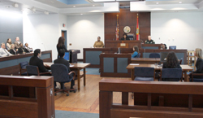
Trial Courts
1 Judge
Jury
Witnesses
Attorneys
Plaintiff/Prosecution – Defense/Defendant
Introduction of evidence

Slide 15
The Role of the Jury (Trial Court)
The jury is to prevent government oppression of the accused.
The jury listens to the evidence during a trial, decides what facts the evidence has established, and draws inferences from those facts to form the basis for their decision.
The jury decides whether a defendant is "guilty" or "not guilty" in criminal cases, and "liable" or "not liable" in civil cases.
Notes:
http://www.americanbar.org/groups/public_education/resources/law_related_education_network/how_courts_work/trialjury_role.html
Emphasize that the jury exists to stand between the government and the accused in order to ensure a fair trial.

Slide 16
Think About it
    What if there were no such thing as jury trials?
    What would the justice system look like in the United States?

Slide 17
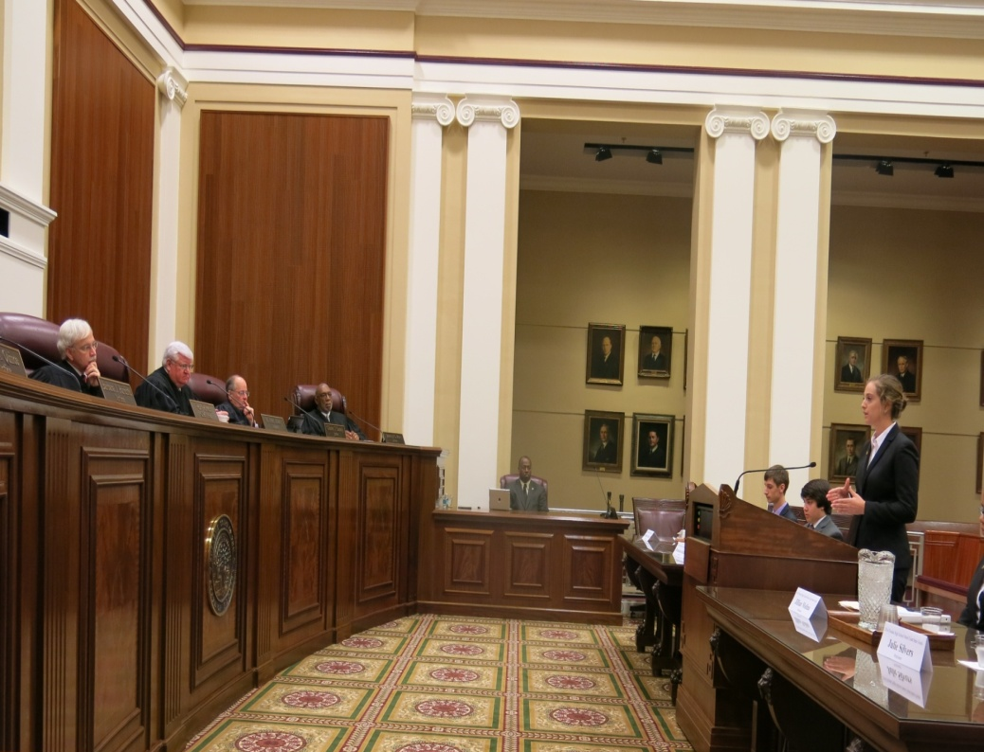
Appellate Courtroom
Panel of judges
No juries
Petitioner/Respondent or Appellant/Appellee
Attorneys submit briefs and present oral arguments on legal or policy issues; no witnesses or presentation of evidence.
Determines if the law was applied correctly and/or if the trial was fair.

Slide 18
What is an appeal?
Is a challenge to a previous legal decision
Notes:
http://www.law.cornell.edu/wex/appeal

Slide 19
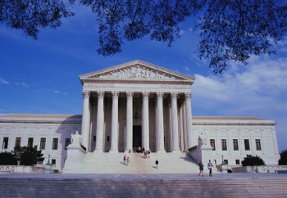
Court Structure
U.S. Supreme
Court
Appeal
Appeal
Florida Supreme
Court
Circuit
Courts of Appeal
13 U.S. Circuit Courts
Appeal
District Courts of Appeal
5 Districts
Appeal
District Courts (Trial Courts)
94 District Courts
Appeal
Circuit Courts
20 Judicial Circuits
County Courts
67 Counties
Trial Courts
Appeal
Florida’s Courts
Federal Courts
Notes:
Encourage students to create their own diagram of the court systems and processes for appeals. Students will need to be able to conceptualize different diagram formats of the courts.

Slide 20
Sort it out!
Work in a small group
Read the two case scenarios provided.
Diagram how the case moved through the courts

Slide 21
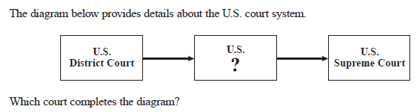

Checking for Understanding

