Slide 1

The Might of the Right
SS.7.C.3.6 Evaluate constitutional rights and their impact on individuals and society.
The impact of constitutional rights on individuals and society
Individual Rights
Notes:
Students will recognize how individual rights shape involvement in the social, political, and economic systems.
Students will recognize how the social, political, and economic systems in the United States are dependent upon individual rights.
Students will use scenarios to recognize and/or evaluate options for exercising constitutional rights.
Students will evaluate the impact of the government upholding and/or restricting individual constitutional rights.

Slide 2
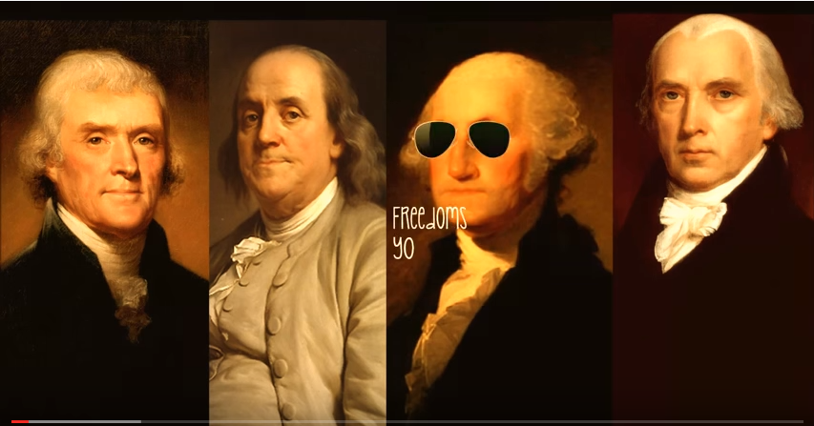
Click image to view Bill of Rights
(Shake It Off)
Published toYouTube by Kristina Edgar
https://www.youtube.com/watch?v=HWPTjFbBj10

Slide 3
What is that right?
The following slides will show pictures of people exercising their individual constitutional rights and the government upholding individual rights.
The question you will need to answer is: what is that right?

Slide 4
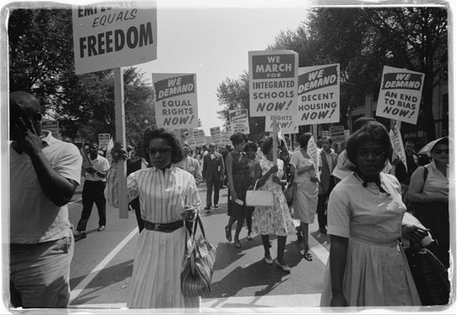
Here we see the right to assembly, the right to freedom of speech, and the right to petition the government being demonstrated.
Civil Rights March on Washington, D.C. / [WKL]. 1963. Library of Congress.
Notes:
Students will use scenarios to recognize and/or evaluate options for exercising constitutional rights.
Freedom of assembly, freedom of speech, freedom of petition (First Amendment)
Individuals exercise these rights in order to make social, political, and economic change. A great example is the Civil Rights Movement.
The government upholds these rights by allowing individuals to express these rights. Tell students that although we have individual rights, there are limits on these rights (this will be addressed later in the presentation)

Slide 5
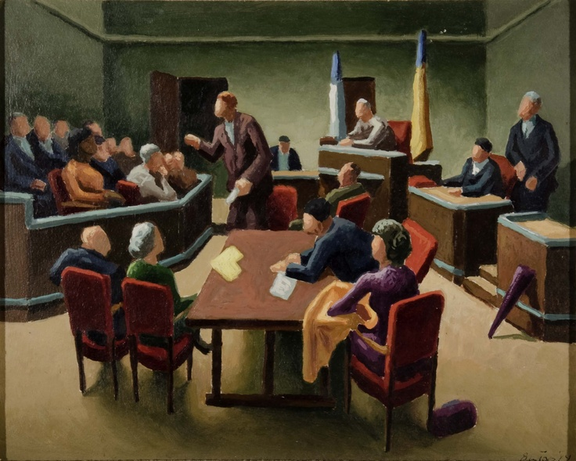
Here we see the right to a trial by jury, legal counsel, and a speedy and public trial. These are individual rights protected by the Constitution and upheld by the government.
https://s-media-cache-ak0.pinimg.com/736x/c0/e6/a6/c0e6a601859bf8a7aa888c85cb28f1f1.jpg
Notes:
Students will evaluate the impact of the government upholding and/or restricting individual constitutional rights.
Right to trial by jury (Amendment 6), Right to legal counsel (Amendment 6), right to a speedy and public trial (Amendment 6)
Explain that the rights of the individual, which would be the rights of those accused of a crime, are upheld by the government and protected by the Constitution. The government is required to allow for these 6th Amendment rights.

Slide 6
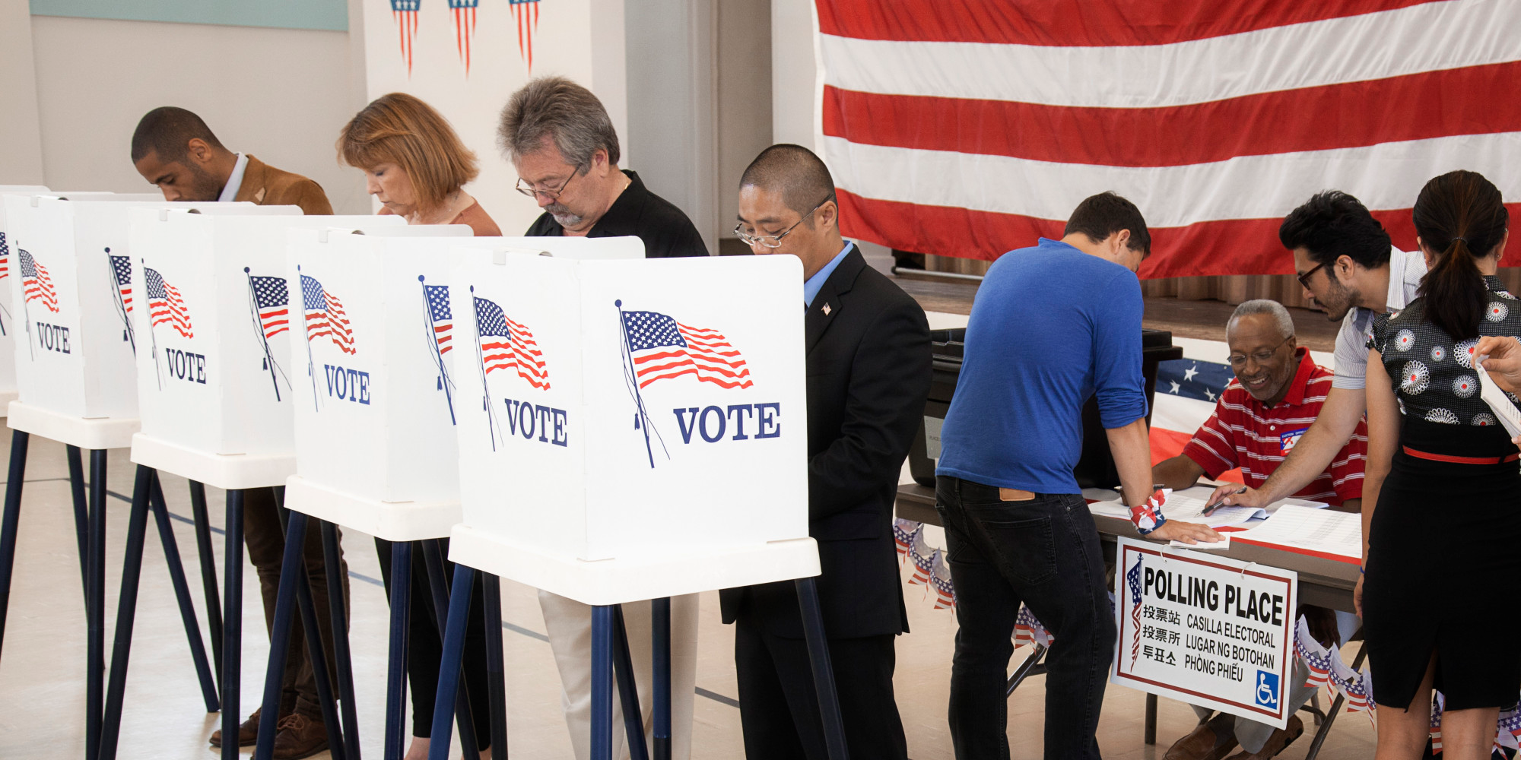
Here we see people exercising their political voice by voting in an election. The Constitution protects the practice of voting in multiple places in the Constitution.
http://politified.com/wp-content/uploads/2016/02/o-VOTE-facebook.jpg
Notes:
Students will use scenarios to recognize and/or evaluate options for exercising constitutional rights.
Voting is addressed in the 15th, 19th, 24th, and 26th amendment to the U.S. Constitution. These amendments state:
The right of citizens of the United States to vote shall not be denied or abridged by the United States or by any state on account of race, color, or previous condition of servitude (15), sex (19), and account of age for those “eighteen years of age or older” (26). The 24th Amendment prohibited poll taxes.
Voting is a critical way individuals can participate in the political life of our country. The Constitution limits government’s ability to limit an individual from voting, although there are certain limitations placed on voting.

Slide 7
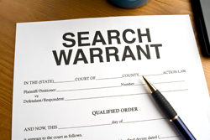
Here we see the government upholding the individual right to protection from unreasonable searches and seizures by getting a search warrant.
http://northiowatoday.com/wp-content/uploads/2016/01/search-warrant.jpg
Notes:
Students will evaluate the impact of the government upholding and/or restricting individual constitutional rights.
Found in the 4th Amendment, the requirement of government to obtain a search warrant based on probable cause is an important safeguard on an individual’s right to privacy and also is a method for government to uphold the rights of the individual.

Slide 8
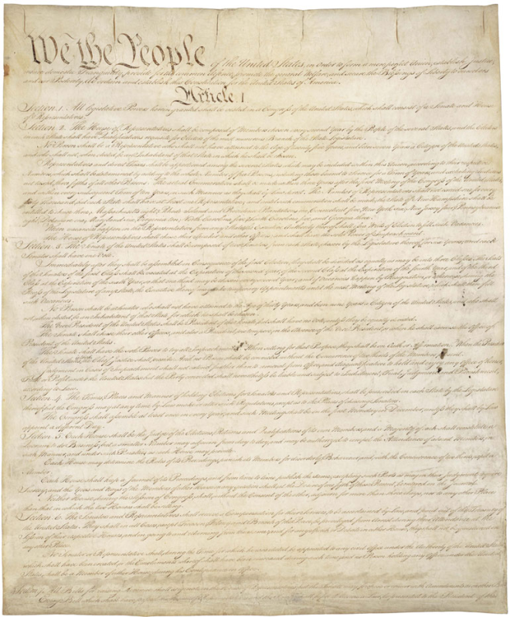
Our individual rights are outlined in the United States and Florida Constitutions
Where can you find your individual rights outlined?
Notes:
Distribute Handout A: List of Individual Rights in the United States Constitution. Students should identify the three individual rights they think are the most important and the three individual rights they think are the least important. Discuss the rights listed to make sure students understand these rights. It is important to remind students that although some of these rights are not ones they use every day, they are important to how individuals and society function every day.

Slide 9
The Ninth Amendment to the U.S. Constitution
What it says:
What it means:
The enumeration in the Constitution, of certain rights, shall not be construed to deny or disparage others retained by the people.
Just because we have the rights that are outlined in the U.S. Constitution, does not mean that we don’t have other rights.
Economic freedom
Right to education (outlined in the Florida Constitution)
Right to travel
What else would you add?

Slide 10
Defining the System
Social, political, and economic systems

Slide 11
Social System
Social systems are the relationships between individuals and groups of people.
Examples:
  Schools/education
  Religion
  Social classes
  Cultures
Notes:
https://www.youtube.com/watch?v=FzEGRCju718

Slide 12
Political System
Political systems are a coordinated set of principles, laws, ideas, procedures, and institutions relating to a certain form of government.
Examples:
  Government (types/systems)
  Courts/justice system
  Laws
  Voting
Notes:
https://www.youtube.com/watch?v=FzEGRCju718

Slide 13
Economic System
An economic system is how a country and/or government distributes resources, trade goods, and services.
Examples:
  Economy
  Money
  Taxes
  Jobs
  Trade
Notes:
http://www.businessdictionary.com/definition/economic-system.html
http://study.com/academy/lesson/economic-systems-definition-types-examples.html
https://www.youtube.com/watch?v=FzEGRCju718

Slide 14
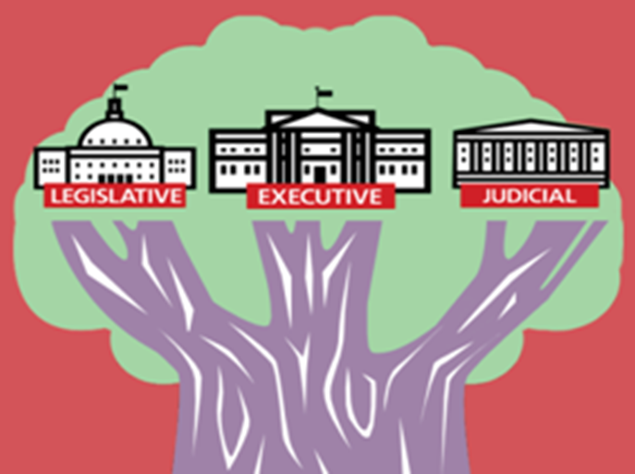
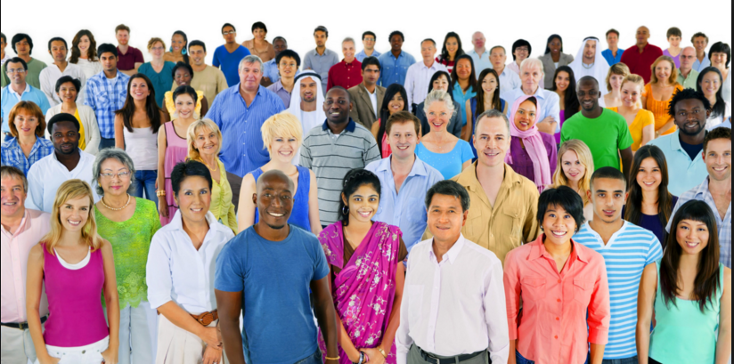

How do individual Rights impact our social, political, and economic systems?
http://crececenter.org/
http://burkemedical.net/wp-content/uploads/2014/10/Economy.jpg
Notes:
Social system picture: http://crececenter.org/
Economic picture: http://burkemedical.net/wp-content/uploads/2014/10/Economy.jpg

Slide 15
Individual Rights and Social Systems
Freedom of Assembly
Examples:
  Schools/education
  Religion
  Social classes
  Cultures
Without these rights, what would be the impact on social systems?
Freedom of Press
Freedom of Speech
Freedom of Religion
Social System
Notes:
Questions to explore with the students:
How does the right to assemble impact your daily life?
Why is the freedom of speech and press so important? (Explore the idea of an informed citizenry)

Slide 16
Individual Rights and Political Systems
Right to petition the government
Right to vote
Examples:
  Government (types/systems)
  Courts/justice system
  Laws
  Voting
Without these rights, what would be the impact on political systems?
Freedom of Press
Freedom of Speech
Freedom of Assembly
Political System
Notes:
Questions to explore with the students:
What would happen if the government, instead of individuals or groups, has control/ownership of the press?
What would happen if our freedom of speech was limited to not include political speech?
What if we couldn’t protest or petition the government?
What if people did not have the right to vote for public officials?

Slide 17


Citizens participate in the political process by:
Voting
Volunteering for a campaign
Joining an interest group
Lobbying the government
Writing to government officials
Running for office
And more!

Slide 18
Civil Disobedience
The refusal to obey certain laws or governmental demands for the purpose of influencing legislation or government policy. Includes nonviolent techniques like:
  Boycotting
  Picketing
  Nonpayment of taxes
Notes:
http://www.dictionary.com/browse/civil-disobedience

Slide 19
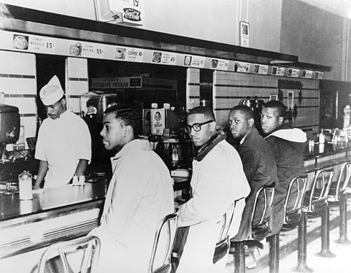
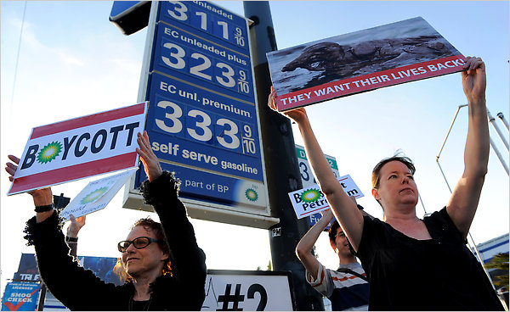
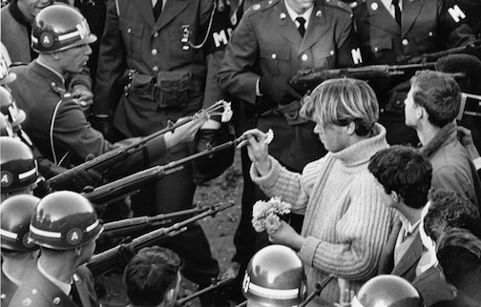
Examples of Civil Disobedience
Notes:
Top left: http://americanhistory.si.edu/brown/history/6-legacy/images/sit-in.jpg
This is a photo of the counter sit ins that took place as part of the Civil Rights Movement, On February 1, 1960, four African American college students sat down at a lunch counter at Woolworth’s in Greensboro, North Carolina, and politely asked for service. Their request was refused. When asked to leave, they remained in their seats. Their passive resistance and peaceful sit-down demand helped ignite a youth-led movement to challenge racial inequality throughout the South. http://americanhistory.si.edu/brown/history/6-legacy/freedom-struggle-2.html
This photo was taken during the Vietnam era when students where protesting the conflict in Vietnam. The young man pictured is placing flowers in he barrels of the guns of the National Guardsmen.
Bottom middle: Flower Power, 1967, photographed by Bernie Boston on October 21, 1967, while he was sitting on the wall of the Mall Entrance of the Pentagon
This is a photo taken after the BP oil spill off of the coast of Florida. Protestors boycotted the business to show their opposition to the company’s drilling practices and the issues created by the oil spill.
Top right: https://static01.nyt.com/images/2010/06/12/business/12money_cnd2/12money_cnd2-articleLarge.jpg

Slide 20
Individual Rights and Economic Systems
Economic Freedom
Examples:
  Economy
  Money
  Taxes
  Jobs
  Trade
Without these rights, what would be the impact on economic systems?
*Property Rights
The 5th Amendment to the U.S. Constitution states that the government cannot take private property for public use without “just compensation”. This is known as eminent domain.
Economic System

Slide 21
How does our government uphold and restrict our individual rights?

Slide 22

Individual Rights Upheld By Government
One of the purposes of the Constitution was to protect the people from the government by outlining the rights of the people.
Notes:
Many individual rights outlined in the Constitution are framed by telling the government what they cannot do and what they must do.

Slide 23
Are there times when government has restricted individual rights?
Why would the government limit:
The freedom of speech?
The freedom of assembly?
The freedom of religion?
What would be another example of the restriction of individual rights?
Notes:
When might the government limit the individual right of speech?
Time, place, and manner restrictions
Speech that interferes with the educational mission of a school
Speech that could incite actions that could cause harm (“FIRE” in a crowded theater)
When might the government limit freedom of assembly?
Time, place, and manner restrictions
Curfews imposed for the purpose of security
When might government limit the practice of religion?
interest of public health and safety
When religious practices interfere with laws that protect the common good

Slide 24
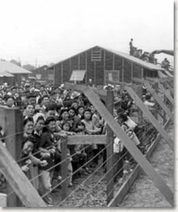
Domestic Security
Forced Internment
In 1942, President Franklin Roosevelt issued Executive Order 9066, granting the U.S. military the power to ban tens of thousands of American citizens of Japanese ancestry from areas deemed critical to domestic security.
The constitutionality of this Executive Order was upheld in the Supreme Court case of Korematsu v. United States.
http://www.pbs.org/wnet/supremecourt/personality/landmark_korematsu.html

Slide 25

Checking for Understanding

