Slide 1
Going Over the “LEJ”
SS.7.C.3.8 Analyze the structure, functions, and processes of the legislative, executive, and judicial branches.
Analyzing the Legislative, Executive, and Judicial Branches

Slide 2
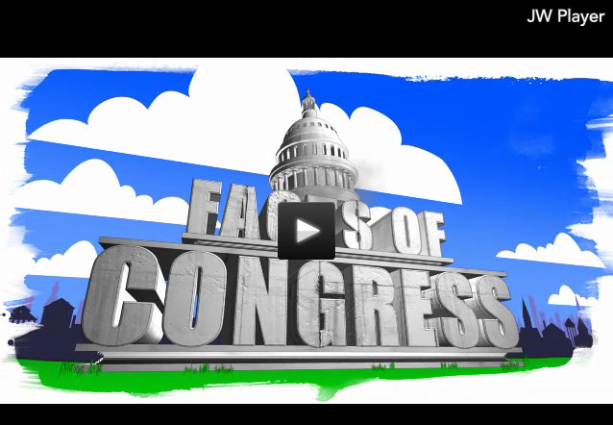
Click the pic for the Federalism Facts of Congress!
(Provided by the Center on Congress)

Slide 3
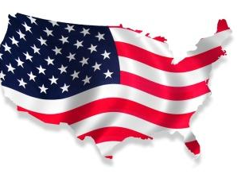
Levels of Government
In our federal system of government, powers are shared between three levels:
Government
Federal
State
Local

Slide 4
Branches of Government
Each level of government has three branches – legislative, executive, and judicial.
Executive Branch
Judicial Branch
These branches all have different powers, responsibilities, and requirements.
Legislative Branch
Federal
State
Local

Slide 5
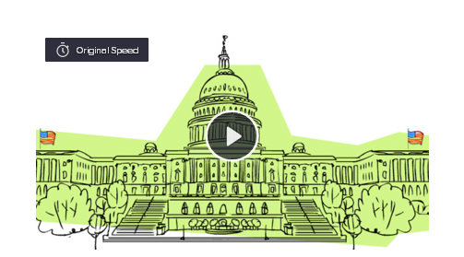
Flocabulary
Click the image to be directed to Flocabulary’s Three Branches of Government Rap
This video and accompanying lyrics were created and published by Flocabulary.
Notes:
Distribute Handout A – Flocabulary Lyrics. Students should follow along. Discuss some of the terms that are in bold on the handout and use the following slide to identify those as powers of the different branches of government.
https://www.flocabulary.com/3-branches-of-government/

Slide 6
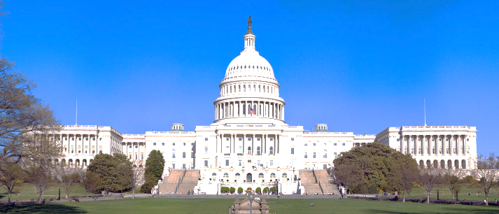
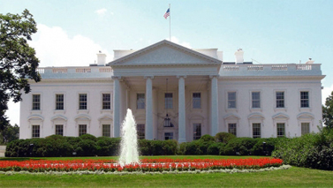
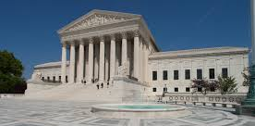
Structure of the Branches
(Federal Government)
ARTICLE 1 Legislative Branch
ARTICLE 3
Judicial Branch
ARTICLE 2
Executive Branch
CONGRESS
Senate
100 members
(2 per state)
Leaders:
President pro tempore of the Senate
Senate Majority Leader
Senate Minority Leader
House of Representatives
435 members
(based on population)
Leaders:
Speaker of the House
House Majority Leader
House Minority Leader
President
Vice President
Cabinet
U.S. Supreme Court
9 Justices
Leader
Chief Justice
Other inferior courts
Notes:
Highlight the leaders of each branch of government.
As a side note, the Vice President serves as the head of the Senate, but the role is more ceremonial. The purpose of having the Vice President serve as the head of the Senate is to be a tie breaker should a vote ever split as well as to provide the opportunity for each state to have equal representation in a vote. If the President of the Senate was elected from the Senators, it would remove them from the vote, causing a state to lose one of its voices in the voting process.
Majority leaders represent the majority party. Minority leaders represent the minority party.
The Chief Justice is one of the nine Justices. There is a Chief Justice and 8 Associate Justices.

Slide 7
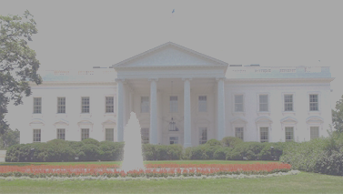
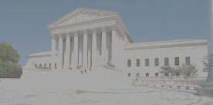

Functions of the Branches
ARTICLE 1 Legislative Branch
(Congress)
ARTICLE 2
Executive Branch
ARTICLE 3
Judicial Branch
Interpret and apply the law
Execute the law
Make Law
Approve the President’s budget
Declare war
Senate approval/rejection of treaties
Senate approval and rejection of Presidential appointments
Impeachment (removal from office)
Approve or veto Congress’ bills
Direct the military
Write the federal budget
Make foreign policy/treaties
Make appointments
Grant pardons
Decide if laws are unconstitutional
Decide court cases
Settle cases between 2 or more states
Notes:
Highlight the roles and responsibilities of each branch of government. Students should compare these roles to see how the separation of power prevents corruption in our government system.
These functions are found in the United States Constitution under the Article associated with each branch.

Slide 8
Processes of the Federal Government
ARTICLE 1 Legislative Branch
(Congress)
ARTICLE 2
Executive Branch
ARTICLE 3
Judicial Branch
Interpret and apply the law
Execute the law
Make Law

Slide 9
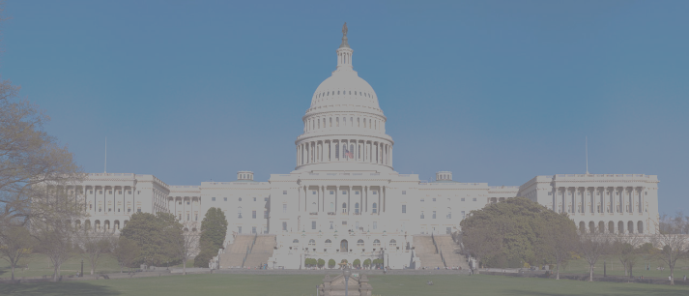
Processes of the Legislative Branch
ARTICLE 1 Legislative Branch
Congress
Create laws through the lawmaking process
Senate confirms and/or denies presidential appointments with a majority vote
Make Law
Selection of members to be on committees
Types of committees:
Standing
Permanent bodies with specific responsibilities including drafting legislation and conducting investigations.
Special (Select)
Temporary committees formed for special purposes; can be short or long-term.
Conference
Specially created when the House and Senate need to reconcile different versions of the same bill.

Slide 10

Processes of the Executive Branch
ARTICLE 2
Executive Branch
Veto legislation
  To “veto” is to reject a decision or proposal of a law-making body
  When Congress sends a bill to the President, s/he can…
H.B.
1415
Increase the federal minimum wage
LAW
Execute the law
Issue executive orders
  Executive orders are orders that are issued by the President that have the force of law
Sign the bill into law
VETO
Veto the bill
Make Appointments
  The President appoints ambassadors, public ministers, Judges of the Supreme Court, and all other officers of the United States
  Must be confirmed by a majority vote of the Senate
Notes:
Highlight the roles and responsibilities of each branch of government. Students should compare these roles to see how the separation of power prevents corruption in our government system.

Slide 11
Processes of the Judicial Branch
ARTICLE 3
Judicial Branch
Judicial review
  The power of courts to decide the constitutionality of acts of the legislative and executive branches of government.
Court orders
  Order that has been written by a judge requiring someone to do something or stop doing something.
Interpret and apply the law
Writs of certiorari
  A writ of certiorari orders a lower court to deliver its record in a case so that the higher court may review it.
Summary judgment
  A case that is decided by a judge without a trial because one or both of the parties contend that all necessary factual issues are settled or so one-sided they need not be tried.
Notes:
http://www.scholastic.com/teachers/article/judicial-review
https://www.law.cornell.edu/wex/writ_of_certiorari
http://dictionary.law.com/default.aspx?selected=2063
Sometimes judges grant summary judgment:
Summary judgement: a court order ruling that no factual issues remain to be tried and therefore a cause of action or all causes of action in a complaint can be decided upon certain facts without trial. A summary judgment is based upon a motion by one of the parties that contends that all necessary factual issues are settled or so one-sided they need not be tried.
Sometimes judges grant summary judgment:
Summary judgement: a court order ruling that no factual issues remain to be tried and therefore a cause of action or all causes of action in a complaint can be decided upon certain facts without trial. A summary judgment is based upon a motion by one of the parties that contends that all necessary factual issues are settled or so one-sided they need not be tried.

Slide 12
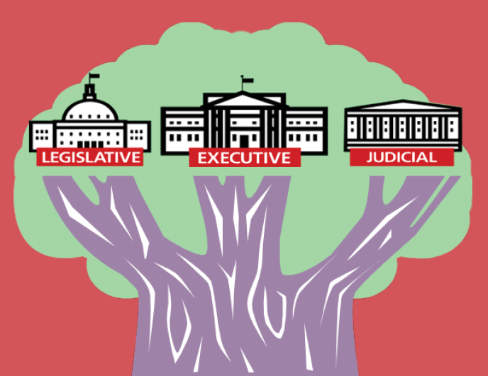
Match It Up
Match the process on your card to the correct branch of government!
Notes:
Label three pieces of chart paper: Legislative, Executive, and Judicial. Distribute one of the process cards to a pair of students and have them match the process to the branch by taping the card on the correct piece of chart paper.

Slide 13
Looking at Lawmaking
Who makes the laws and how are they made?

Slide 14
The Hierarchy of Law
The U.S. Constitution is the “Supreme Law of the Land.”
United States Constitution
Acts of
Congress
U.S. Congressmen/Congresswomen
(U.S. Representatives and U.S. Senators)
Made by
Florida Constitution
State Statutes (laws)
State legislators (Representatives and Senators)
Made by
City and County Ordinances
City/county commissioners/ council members
Made by
Notes:
Highlight the hierarchy of law. The US Constitution as the highest law in the land. Explain that if there is a conflict between a lower law and a higher one, the higher one “prevails”.
Amending the Florida and U.S. Constitution will be addressed in Benchmark SS.7.C.3.5.

Slide 15
Which is Which?
Read the following laws and determine if they are a:
Local ordinance
State statute
Federal act

Slide 16
State Statute!
Bullying or harassment of any student or employee of a public K-12 educational institution is prohibited…“Bullying” includes cyberbullying and means systematically and chronically inflicting physical hurt or psychological distress on one or more students…
Notes:
Ask students which key words in the law would help them know it is a state statute. For this law, the wording that would help them identify this as a state-level law is the focus on education.
FS 1006.147 Bullying and harassment prohibited.
http://www.leg.state.fl.us/statutes/index.cfm?App_mode=Display_Statute&URL=1000-1099/1006/Sections/1006.147.html

Slide 17

Federal ACT!
From the Civil Rights Act of 1964
Title VII makes it illegal to discriminate against an employee or job applicant on the basis of his or her race, color, religion, national origin, or sex (including pregnancy).

Slide 18

Local Ordinance!
The saggy pants law takes aim at anyone on city property wearing his or her pants two inches below their natural waist in a way that exposes their underwear or backside.
Notes:
http://tampa.cbslocal.com/2014/09/17/florida-city-repeals-saggy-pants-ordinance-after-legal-threats-from-naacp/
This local ordinance has been repealed since its initial implementation.

Slide 19
Click the pic to see a Fact of Congress on how a bill becomes a law!
(Provided by the Center on Congress)

Slide 20
How a Bill Becomes a Law on the Federal Level
Bill Proposed
From citizen, group (like a special interest group) or legislator. A sponsor and supporters introduce the bill
.
Bill Introduced
The Bill is placed in the hopper on the clerk’s desk and is assigned a number. The bill is then sent to the appropriate committee.
Bill Goes to Committee
Bill is reviewed, researched, and voted on. If it passes, it is sent to the House floor.
Bill is reported
The bill is sent back to the House and is ready to be debated by the U.S. House of Representatives.
Once the bills are identical…
Yea! Nay!
The Bill is Debated
Representatives discuss the bill and explain why they agree or disagree with it
The Bill is Voted On
If a majority of the Representatives say or select yes, the bill passes in the U.S. House of Representatives. The bill is then certified by the Clerk of the House and delivered to the U.S. Senate.
The Bill is Referred to the Senate
The bill is discussed in a Senate committee and then reported to the Senate floor to be voted on. Senators vote by voice (“yea” or “nay”).
Bill is Sent to the President
If the President does not veto the bill, the bill becomes law.
Notes:
Remind students that special interest groups are groups of people that come together to impact policy based on a common cause. Some examples include Mothers Against Drunk Driving (MADD), People for the Ethical Treatment of Animals (PETA), the National Rifle Association (NRA), and others.
There are three options when the bill reaches the President.
Sign and pass the bill—the bill becomes a law.
2. Refuse to sign, or veto, the bill—the bill is sent back to the U.S. House of Representatives, along with the President’s reasons for the veto. If the U.S. House of Representatives and the U.S. Senate still believe the bill should become a law, they can hold another vote on the bill. If two-thirds of the Representatives and Senators support the bill, the President’s veto is overridden and the bill becomes a law.
3. Do nothing (pocket veto)—if Congress is in session, the bill automatically becomes law after 10 days. If Congress is not in session, the bill does not become a law.
http://kids.clerk.house.gov/grade-school/lesson.html?intID=17

Slide 21
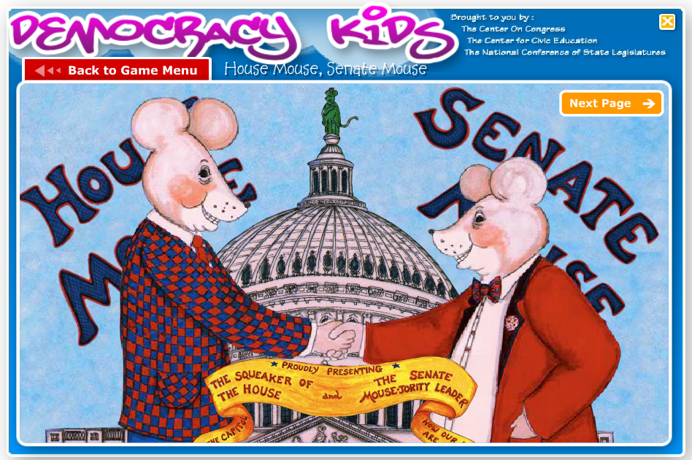
House Mouse, Senate Mouse
Click the photo to be directed to House Mouse Senate Mouse on Democracy Kids! (Provided by the Center on Congress)

Slide 22
How a Law is Made in Florida
IDEA
From citizen, group (like a special interest group) or legislator
.
BILL DRAFTED
Bill written by staff and assigned a number. For this example, the bill will start in the Florida House of Representatives.
COMMITTEE ASSIGNMENT
/MEETING
Bill is reviewed, voted on, and can be placed on calendar or allowed to die in committee.
READING AND VOTE
The bill is voted on in the Florida House and may die if it does not receive a favorable vote.
Once the bills are identical…
Sent to Senate for Action
Same process as original Chamber (the House) – committees, readings, and vote.
GOVERNOR CONSIDERATION
Governor can sign the bill into law, allow the bill to become law without signing, or veto the bill.
GOVERNOR FINAL ACTIONS
If the Governor vetoes the bill, the Legislature may override his/her veto by a 2/3 vote.
LAW
If the Governor does not veto the bill, the bill becomes law.
Notes:
Remind students that special interest groups are groups of people that come together to impact policy based on a common cause. Some examples include Mothers Against Drunk Driving (MADD), People for the Ethical Treatment of Animals (PETA), the National Rifle Association (NRA), and others.

Slide 23
Local Ordinances
Procedures for adopting ordinances are found in Florida Statutes (laws) under 166.041:
The ordinance must be single subject;
The subject shall be clearly stated in the title;
There will be public hearings and notices in the newspaper about the proposed change;
Ordinance passes if a majority of the governing body is present and a majority of the body votes to enact the ordinance.

Slide 24
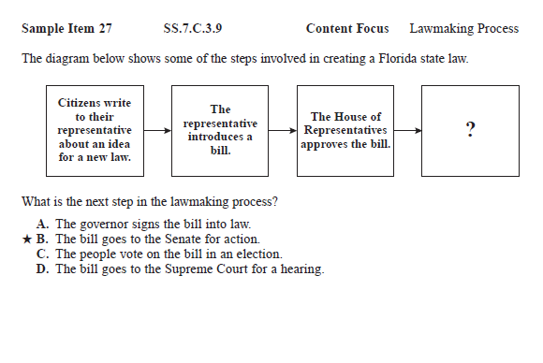
Check For Understanding
What are some important words to look for in this question?
Which answers can we eliminate?

Slide 25
You be the author!
Choose either the state or federal lawmaking process. Write and illustrate a short children's book about how a bill becomes a law!
Notes:
Provide students with printouts of either slide 16 (federal) or slide 18 (state) to help guide them in creating a short children’s book outlining the lawmaking process. If possible, have students read their books to a younger audience or another class of students.

