Slide 1
International Conflict Advisory Committee
SS.7.C.4.3 Describe examples of how the United States has
dealt with international conflicts.
Dealing with international conflicts and incidents
Notes:
Students will identify specific examples of international conflicts in
which the United States has been involved.
Students will identify the reasons for the United States becoming
involved in past international conflicts.
Students will analyze primary source documents pertaining to
international incidents to determine the course of action taken by the
United States.
Students will identify the different methods used by the United States
to deal with international conflicts.

Slide 2
Review: What are the goals and objectives of foreign policy?
The Department of State has four main foreign policy goals:
Protect the United States and Americans;
Advance democracy, human rights, and other global interests;
Promote international understanding of American values and policies; and
Support U.S. diplomats, government officials, and all other personnel at home and abroad who make these goals a reality.
Notes:
http://www.state.gov/r/pa/ei/rls/dos/107330.htm
http://diplomacy.state.gov/discoverdiplomacy/diplomacy101/issues/170609.htm
Discuss each goal/objective with the students.
For example, what do you think the U.S. and American citizens needs protection from?
Answers that could follow: from the threats of terrorism, weapons of mass destruction, infectious diseases, drug trafficking, crime, and environmental degradation
How can we advance democracy?
Answers that could follow: by assisting newly formed democracies and denouncing regimes that deny their citizens the right to choose their leaders in free, fair, and transparent elections.
How do we defend human rights? by holding governments accountable to their obligations under human rights standards and agreements; fostering greater respect for human rights; promoting the rule of law, seeking accountability, and changing cultures of impunity; and assisting efforts to reform and strengthen the UN Commission on Human Rights.
How can we encourage economic growth and prosperity?
by supporting economic development through increased investment and exports and democratization and by reducing poverty and fighting disease
How can we promote understanding of American values and policies?
by engaging international audiences through official events and public programs at embassies around the world and by people-to-people exchange programs in a broad array of fields, including the arts, culture, education, sports, and science

Slide 3
Dealing With International Conflicts
Diplomatic talks
Conflict resolution
Peacekeeping efforts
Humanitarian efforts
Banning trade (embargo)
Military action
In most situations, international conflicts are approached in this order: international conflicts- begin with diplomatic talks and progressing to military action if needed.
Notes:
Emphasize to students that in most situations, countries that have some kind of incident/conflict typically work to remedy those issues through diplomatic talks, various peacekeeping efforts, with progression to the banning of trade/sanctions and then military action like blockades, movement of troops, and military operations.

Slide 4
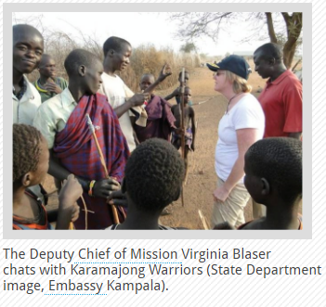
Diplomacy
The art and practice of conducting negotiations and maintaining relations between nations; skill in handling affairs without arousing hostility
http://diplomacy.state.gov/discoverdiplomacy/diplomacy101/people/170305.htm

Slide 5
Peacekeeping Efforts
United Nations Peacekeeping helps countries torn by conflict create conditions for lasting peace.
Peacekeeping is not only to maintain peace and security – it also:
Facilitates the political process,
Protects civilians,
Assists in the disarmament, demobilization and reintegration of former combatants;
Supports the organization of elections,
Protects and promotes human rights and
Assists in restoring the rule of law.
http://www.un.org/en/peacekeeping/operations/peacekeeping.shtml

Slide 6
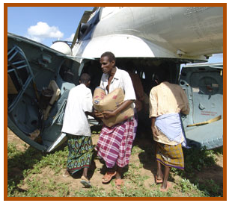
Humanitarian Aid
Humanitarian assistance is generally accepted to mean the aid and action designed to:
Save lives;
Alleviate suffering and maintain and protect human dignity during and in the aftermath of man-made crises and natural disasters; and
Prevent and strengthen preparedness for the occurrence of such situations.
http://www.un.org/en/globalissues/humanitarian/
http://www.globalhumanitarianassistance.org/data-guides/defining-humanitarian-aid/
Notes:
Encourage students to think of contemporary examples of humanitarian aid. Some examples include: sending assistance to help in foreign countries following a natural disaster (Haiti, India, Western Africa, etc.), providing assistance to people during times of political crisis (Syrian refugees), and providing support for countries with disease and famine.

Slide 7
Embargos and Sanctions
Embargo
Sanction
Governmental restriction of trade; official ban on trade or other commercial activity
An action that is taken or an order that is given to force a country to obey international laws by limiting or stopping trade with that country, by not allowing economic aid for that country, etc.
Notes:
http://www.merriam-webster.com/dictionary/sanction
http://www.dictionary.com/browse/embargo
https://www.google.com/search?q=embargo+definition&rlz=1C1CHWA_enUS587US587&oq=embargo&aqs=chrome.1.69i59l2j0l4.2923j0j4&sourceid=chrome&ie=UTF-8

Slide 8
Military Action
Military action can include:
Sending in troops for peacekeeping efforts in order to provide support and maintain security
Providing troops to assist an existing military effort
Enacting blockades, or stopping people or supplies from entering or leaving a port or country
Declaration of war on another country
Notes:
http://www.merriam-webster.com/dictionary/blockade

Slide 9
You’re the Committee!
You will now be on an International Advisory Committee where you will learn about an international conflict/incident and provide an advisory opinion on how the U.S. should handle the situation.

Slide 10
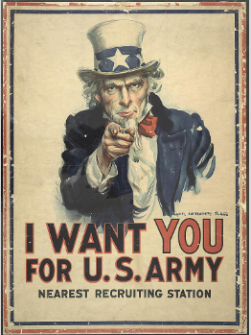
World War I
During WWI, the United States officially declared war on Germany in 1917.
Source: Flagg, James Montgomery, Artist. I want you for U.S. Army: nearest recruiting station / James Montgomery Flagg. ca. 1917. Image. Retrieved from the Library of Congress, https://www.loc.gov/item/96507165/.

Slide 11
World War II
“Yesterday, December 7, 1941—a date which will live in infamy—the United States of America was suddenly and deliberately attacked by naval and air forces of the Empire of Japan…
I ask that the Congress declare that since the unprovoked and dastardly attack by Japan on Sunday, December 7, 1941, a state of war has existed between the United States and the Japanese Empire.”
Notes:
President Franklin D. Roosevelt

Slide 12
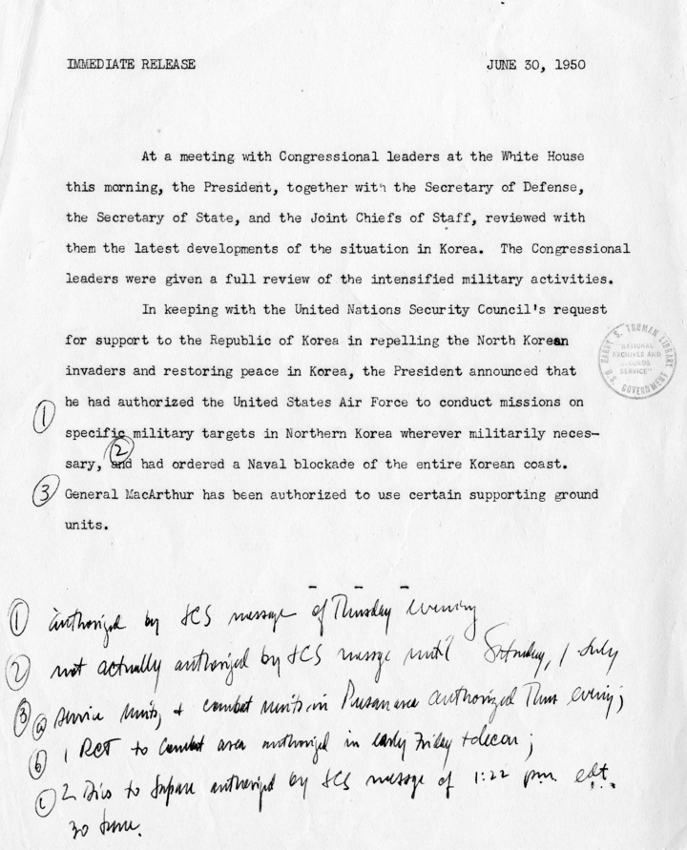
Korean War
The President authorized military intervention on behalf of South Korea (Republic of Korea) by sending in Air Force missions, a Naval blockade, and ground support under the direction of General MacArthur.

Slide 13
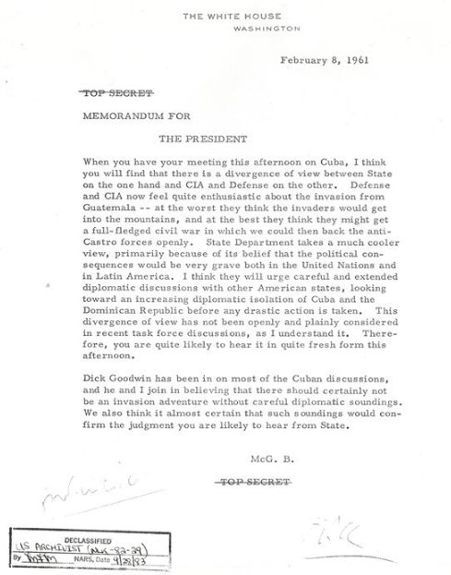
Bay of Pigs
The failed military strike in the Bay of Pigs was a controversial and hotly debated move by the United States, as evidenced in the memo for the President.

Slide 14
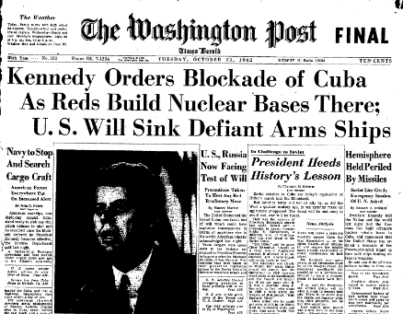
Cuban Missile Crisis
The Cuban Missile Crisis was an example of the use of diplomatic negotiations to prevent what many people feared would be a nuclear war.
The U.S. also used strategies like blockades and embargoes to force negotiations.

Slide 15
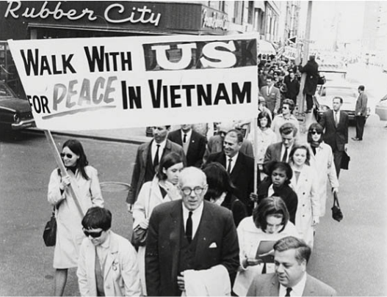
Vietnam War
The military action taken in the Vietnam War (conflict*) was controversial on the home front as casualties mounted to more than 3 million people, among those 58,000 Americans.
Source: https://www.loc.gov/exhibits/haventohome/timeline/images/_cards/1970_075_card.jpg
Notes:
*The United States Congress never officially declared war, however the level of military operations has resulted in it being referred to as a war.

Slide 16
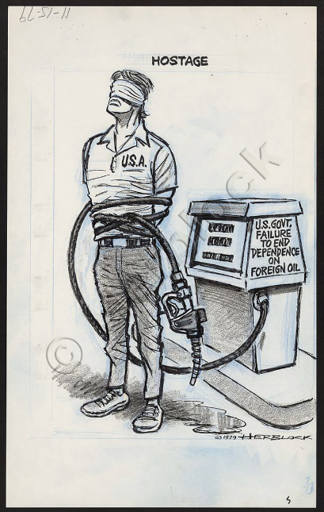
Iran Hostage Crisis
The Iran Hostage Crisis was an example of diplomatic negotiations to release the hostages while not creating hostilities.
Source: Hostage, 1979. Graphite, porous point pen, ink, and opaque white over blue pencil underdrawing. Published in the Washington Post, November 15, 1979. Prints and Photographs Division, Library of Congress (54.00.00). LC-DIG-ppmsca-21949
https://www.loc.gov/exhibits/herblock/ItGetsIntoEverything/Assets/21949v_enlarge.jpg

Slide 17
Gulf War I
“At my direction, elements of the 82d Airborne Division as well as key units of the United States Air Force are arriving today to take up defensive positions in Saudi Arabia. I took this action to assist the Saudi Arabian Government in the defense of its homeland. No one commits America's Armed Forces to a dangerous mission lightly, but after perhaps unparalleled international consultation and exhausting every alternative, it became necessary to take this action.”
Notes:
President George H.W. Bush

Slide 18
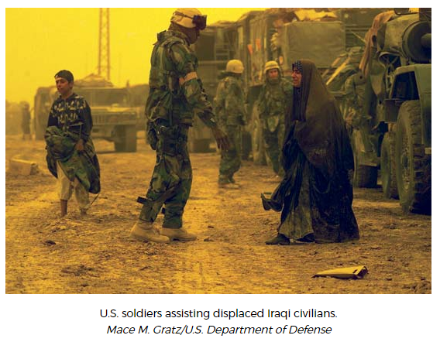
Second Gulf War
In addition to military action in the Second Gulf War, humanitarian efforts were also a focus in rebuilding a country torn by war and political struggle.
Notes:
Also tell students that the Second Gulf War is also referred to as the “War on Terror” where the U.S. and other countries throughout the world are working to eliminate terrorism (use of violence or threats against a group/nation/state/government; usually with a political aim/goal) internationally.
http://www.merriam-webster.com/dictionary/terrorism

Slide 19
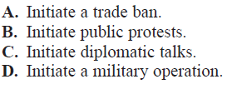
Checking for Understanding

