Slide 1
College and Career Planning
Your future awaits!

Slide 2
Many options, One Destination: Your Goal
Diploma Options
Dual Enrollment
Career/Technical Pathways
College or University
High School Acceleration

Slide 3
Earn High School Credits in Middle School
Middle grades students in grades 6, 7, and 8 may enroll in selected senior high school courses for the purposes of pursuing a more challenging program of study. ​
Such courses are included when computing grade point averages (GPA) and rank in class. ​ ​
Up to six credits may be earned, with parental permission, in grades 6, 7, and/or 8, for courses taken, which may be applied toward the total credits needed for graduation, college admission, or for the Florida Bright Futures Scholarship Program requirements.

Slide 4
High School Graduation Requirements
24 credits
4 English
4 Math (Algebra 1, Geometry + two additional math courses)
3 Science (Biology + two other science courses)
3 Social Studies (World History, U.S. History, U.S. Government/ Economics)
1 Fine/Practical Art
0.5 Personal Fitness/ 0.5 Physical Education
8 Electives
Minimum 2.0 Grade Point Average (GPA)
Passing scores on Reading and Math assessments
Community service project
Online course requirement

Slide 5
Florida Bright Futures Scholarship
The Florida Bright Futures Scholarship is also known as the Florida Financial Aid Application (FFAA)
The Florida Bright Futures Scholarship was created to establish a scholarship program to reward any Florida high school graduate who merits recognition of high academic achievement.
It is a renewable scholarship that provides incentive for academically talented students to stay in-state for college.
If qualifications are met, 100 or 75 percent of tuition may be paid.

Slide 6
Florida Bright Futures Scholarship
There are four types of Florida Bright Futures Scholarships
Florida Academic Scholarship (FAS)
Florida Medallion Scholarship (FMS)
Florida Gold Seal CAPE Scholarship (GSC)
Florida Gold Seal Vocational Scholarship (GSV)

Slide 7
Florida academic and medallion scholarships

Slide 8
Florida's State Universities Admissions Requirements
Florida State universities have a competitive selection process. To be eligible for admission to a state university, a student must meet these minimum requirements:
Earn a standard high school diploma with a minimum 2.5 GPA in 18 core academic courses which are:
4 courses in English (at least three with substantial writing)
4 courses in math (Algebra I and higher level courses)
3 courses in natural science (at least two with a lab)
3 courses in social studies
2 courses in the same foreign language
2 electives
--Florida Shines

Slide 9
Florida College requirements
State colleges have an "open door" admissions process.
To be eligible for admission to a state college, a student must earn a standard high school diploma or its equivalent (General Educational Development – GED – or adult high school diploma) or demonstrate success in college coursework.
Many students choose to complete their first two postsecondary years at a college and then transfer to a university to complete their final two years.
-- Florida Shines

Slide 10
Technical Colleges and centers
Florida's Postsecondary Technical Colleges & Centers are responsible for developing and maintaining educational programs that prepare individuals for occupations important to Florida's economic development.
To be eligible for admission to a technical college, a student must earn a standard high school diploma or its equivalent (General Educational Development – GED – or adult high school diploma) or demonstrate success in college coursework.
There are seven technical colleges in Miami-Dade County Public Schools, and students can earn certifications in various programs in as little as one year.
The programs offered provide career pathways in the following fields.

Slide 11
Mdcps Technical colleges
Programs
Culinary Arts
Energy
Information Technology
Personal Services
Manufacturing
Commercial Art
Construction
Healthcare Occupations
Licensed Childcare
Public Safety & Security
Transportation
Campuses:
George T. Baker Aviation
D.A. Dorsey Technical College
The English Center
Lindsey Hopkins Technical College
Miami Lakes Educational Center & Technical College
Robert Morgan Educational Center & Technical College
South Dade Technical College

Slide 12
Career and technical education (cte)
Career and Technical Education helps students learn skills to make them competitive and employable.
The wide range of career and technical programs prepare students for graduation, postsecondary education and careers.
Thousands of Miami-Dade CTE students achieve industry certification in their program of study, including one or more of the following credentials:
Adobe - Visual Design
Autodesk AutoCAD
Clinical Medical Assistant
CompTIA Network+
Food Protection Manager (ServSafe®)
Entrepreneurship & Small Business
Microsoft Office 2016 Master
Social Media Specialist (CIW)
Quickbooks
. . . and many more industry certification opportunities!

Slide 13
Diploma pathways
Advanced International Certificate of Education Program (AICE)
Superintendent's Diploma of Distinction
Merit
Designation
Advanced Placement (AP)
Capstone
Scholar Designation
Seal of Biliteracy
International Baccalaureate (IB)
Standard Diploma

Slide 14
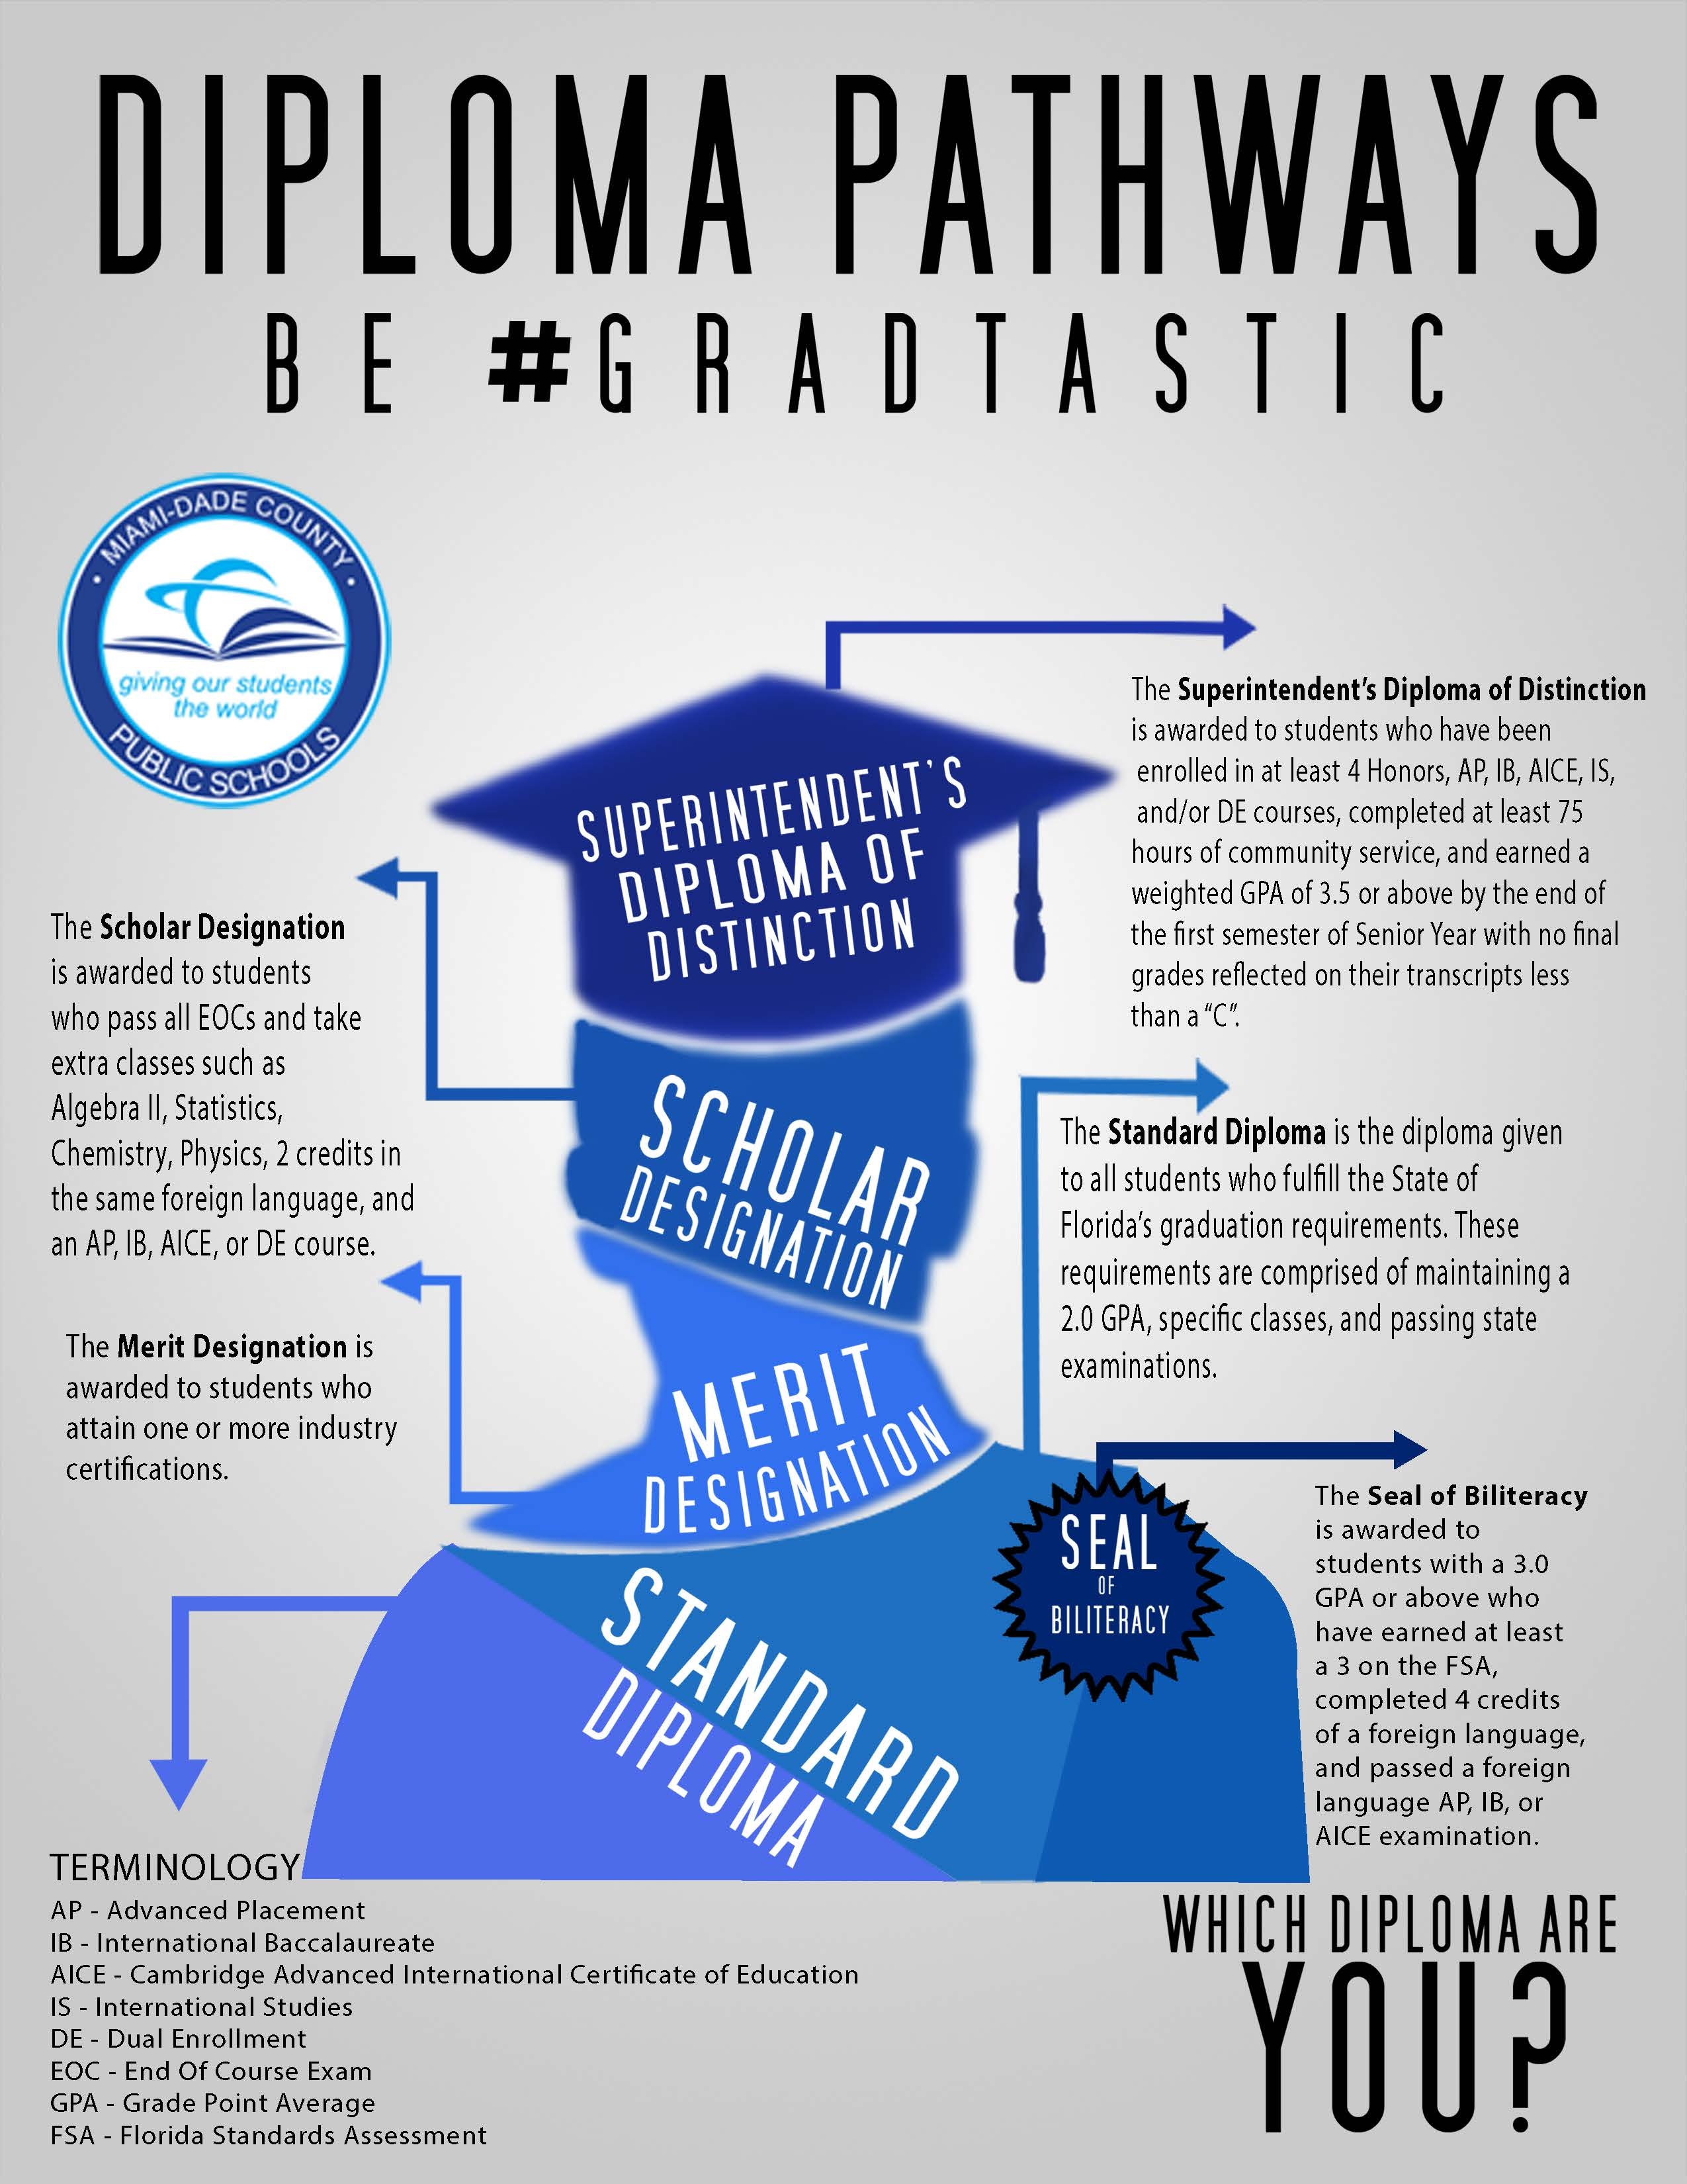
What type of diploma designation will you earn?
Superintendent's Diploma of Designation
Scholar Designation
Merit Designation
Standard Diploma
Seal of Biliteracy

Slide 15
ADVANCED INTERNATIONAL CERTIFICATE OF EDUCATION PROGRAM (AICE) ADVANCED PLACEMENT PROGRAMS (AP) INTERNATIONAL BACCALAUREATE PROGRAMS (IB)

Slide 16
What are the diploma options?
Students must successfully complete one of the following diploma options:
• 24-credit standard diploma
• 18-credit Academically Challenging Curriculum to Enhance Learning (ACCEL)
• Career and Technical Education (CTE) Pathway
• Advanced International Certificate of Education (AICE) curriculum
• International Baccalaureate (IB) Diploma curriculum

Slide 17
24-Credit diploma and 18-credit option
24-Credit Standard Diploma
The purpose of the standard diploma is to certify that the student has met all District and State standards for graduation. Beginning with students entering their 9th grade year, this diploma will be awarded to graduates that have successfully completed the required 24 credits, an International Baccalaureate curriculum, or an Advanced International Certificate of Education curriculum and attained a cumulative grade point average of 2.0 on a 4.0 scale. Also, students must pass the statewide standardized assessments or attain the concordant and/or comparative examination scores, applicable to the cohort year when the student entered 9th grade.
18-Credit Academically Challenging Curriculum to Enhance Learning (ACCEL)
What is the difference between the 18-credit ACCEL option and the 24-credit option?
• 3 elective credits instead of 8
• Physical Education is not required.
• Online course is not required.

Slide 18
Career and technical education (cte) diploma pathway
What is the difference between the CTE Pathway option and the 24-credit option?
• At least 18 credits are required.
• 4 elective credits instead of 8
• 2 credits in CTE courses, must result in program completion and industry
certification
• 2 credits in work-based learning programs or up to 2 elective credits, including
financial literacy
• Physical Education is not required.
• Fine and Performing Arts, Speech and Debate or Practical Arts are not required.
• Online course is not required.

Slide 19
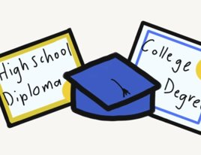
Dual enrollment
Dual Enrollment (DE) allows qualified students to enroll in college courses through local and state colleges and universities while still in high school.
Credit earned through DE can be used towards fulfillment of a high school graduation requirement and can also be used as college credit.
Students who qualify may enroll in a college course, and the tuition and textbook cost is waived.
In order to qualify for dual enrollment, students must have a 3.0 unweighted grade point average (GPA) and meet all the college/university criteria for admission.
All M-DCPS senior high schools offer DE opportunities.

Slide 20
Dual enrollment
There are 2 types of dual enrollment:
College
Career
The credits that students earn at local colleges/universities count toward high school graduation and can also be applied to a college degree or certificate.
You and your parents save money because dual enrollment students are exempt from paying tuition, fees, and books.
It will take you less time to attain a college degree or certificate because you will get credits that are transferrable to a college or university.
Enrolling at a local college/university gives outstanding high school and middle school students a wider range of courses to choose from.
Use your high school academy and technical program courses to earn college credits.
Offering high school and technical college students a head start on college and careers.
Technical programs of study in high school integrate academic and career education. Students who complete a technical program of study along with required academic courses and graduate with a high school diploma, may get college credit for those courses.

Slide 21
Additional resources
Standard Diploma Requirements
Assessments Requirements
Florida Bright Futures- FAS-FMS
Bright Futures Brochure
Diploma Pathways
Miami Dade County Public Schools Technical Colleges
What is Career and Technical Education?
College and Career Ready through CTE
CTE Readiness for All Careers
CTE Pathways

