Slide 1
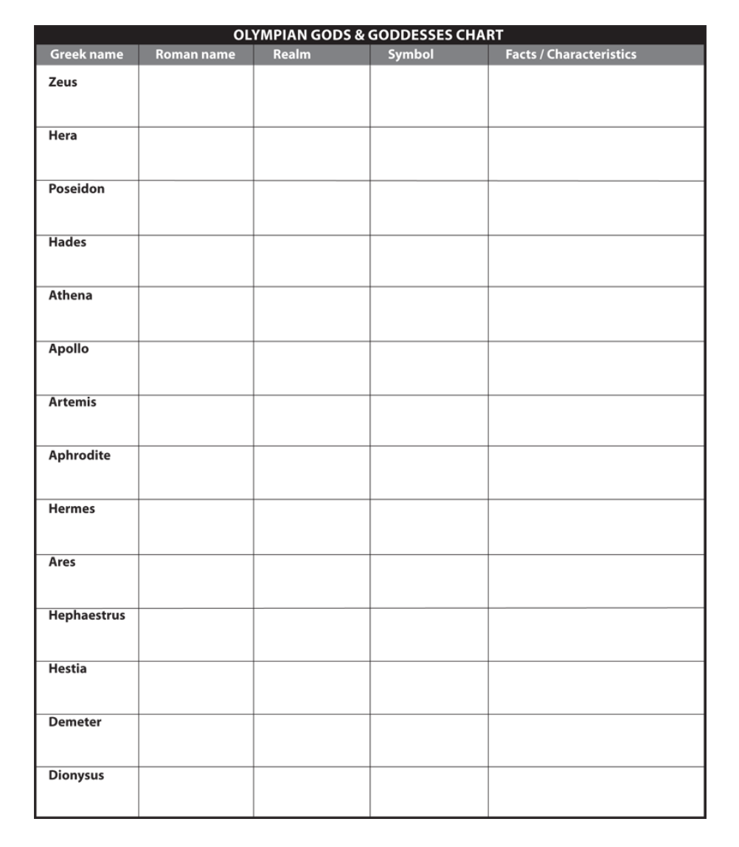
Greek and Roman Mythology Comparison Directions: Students are to fill the provided template to work on
World History: Complete slides 1-21 and slide 30 Advanced/Gifted World History: Complete all slides (1-30)
Name:
Date:
Period:

Slide 2
Greek Name: Zeus Roman Name: ?
Image Source:
Realm:
Symbol/Weapons/Tools:
Powers/Attributes:
Spouse/Children:
Facts/Characteristics:

Slide 3
Famous Myth of Zeus:

Slide 4
Greek Name: Hera Roman Name: ?
Realm:
Symbol/Weapons/Tools:
Powers/Attributes:
Spouse/Children:
Facts/Characteristics:
Image:

Slide 5
Famous Myth of Hera:

Slide 6
Greek Name: Posideon Roman Name: ?
Realm:
Symbol/Weapons/Tools:
Powers/Attributes:
Spouse/Children:
Facts/Characteristics:
Image:

Slide 7
Famous Myth of Posideon:

Slide 8
Greek Name: Hades Roman Name: ?
Realm:
Symbol/Weapons/Tools:
Powers/Attributes:
Spouse/Children:
Facts/Characteristics:
Image:

Slide 9
Famous Myth of Hades:

Slide 10
Greek Name: Athena Roman Name: ?
Realm:
Symbol/Weapons/Tools:
Powers/Attributes:
Spouse/Children:
Facts/Characteristics:
Image:

Slide 11
Famous Myth of Athena:

Slide 12
Greek Name: Apollo Roman Name: ?
Realm:
Symbol/Weapons/Tools:
Powers/Attributes:
Spouse/Children:
Facts/Characteristics:
Image:

Slide 13
Famous Myth of Apollo:

Slide 14
Greek Name: Artemis Roman Name: ?
Realm:
Symbol/Weapons/Tools:
Powers/Attributes:
Spouse/Children:
Facts/Characteristics:
Image:

Slide 15
Famous Myth of Artemis:

Slide 16
Greek Name: Aphrodite Roman Name: ?
Realm:
Symbol/Weapons/Tools:
Powers/Attributes:
Spouse/Children:
Facts/Characteristics:
Image:

Slide 17
Famous Myth of Aphrodite:

Slide 18
Greek Name: Hermes Roman Name: ?
Realm:
Symbol/Weapons/Tools:
Powers/Attributes:
Spouse/Children:
Facts/Characteristics:
Image:

Slide 19
Famous Myth of Hermes:

Slide 20
Greek Name: Ares Roman Name: ?
Realm:
Symbol/Weapons/Tools:
Powers/Attributes:
Spouse/Children:
Facts/Characteristics:
Image:

Slide 21
Famous Myth of Ares:

Slide 22
Greek Name: Hephaestrus Roman Name: ?
Realm:
Symbol/Weapons/Tools:
Powers/Attributes:
Spouse/Children:
Facts/Characteristics:
Image:

Slide 23
Famous Myth of Hephaestrus:

Slide 24
Greek Name: Hestia Roman Name: ?
Realm:
Symbol/Weapons/Tools:
Powers/Attributes:
Spouse/Children:
Facts/Characteristics:
Image:

Slide 25
Famous Myth of Hestia:

Slide 26
Greek Name: Demeter Roman Name: ?
Realm:
Symbol/Weapons/Tools:
Powers/Attributes:
Spouse/Children:
Facts/Characteristics:
Image:

Slide 27
Famous Myth of Demeter:

Slide 28
Greek Name: Dionysus Roman Name: ?
Realm:
Symbol/Weapons/Tools:
Powers/Attributes:
Spouse/Children:
Facts/Characteristics:
Image:

Slide 29
Famous Myth of Dionysus:

Slide 30
Sources:
Mensa for Kids -https://www.mensaforkids.org/teach/lesson-plans/an-introduction-to-greek-mythology/
-Web references
Some Great Greek Myths
Mythweb
MythMan
Mythography
Encyclopedia Mythica
Additional Student Sources:
-

